Slide 1
Stories of the Earth and Sky
Grade 4, Unit 5
CCSS Curriculum Maps
Old Wire Elementary School

Slide 2


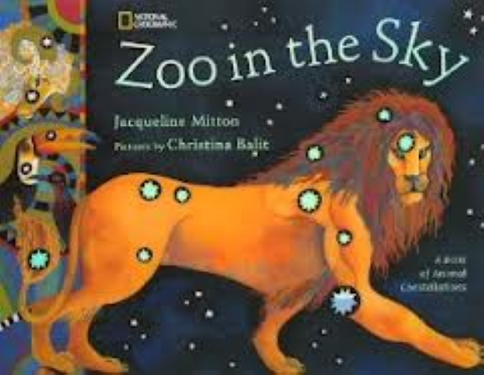
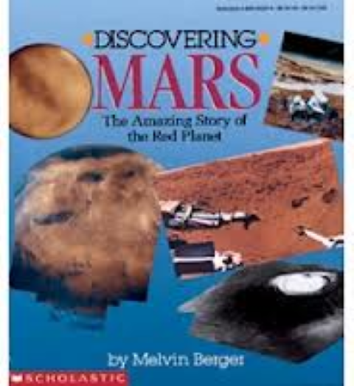
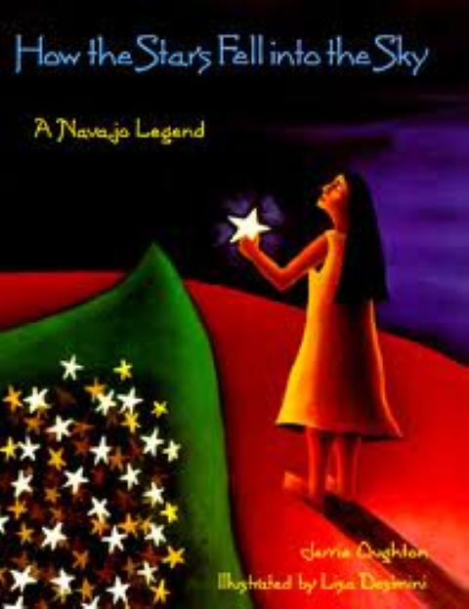
How are the earth and sky portrayed in fiction and non-fiction?

Slide 3

Grandmother Spider Brings The Sun to Earth
A Native American Story of the Sky

Slide 4
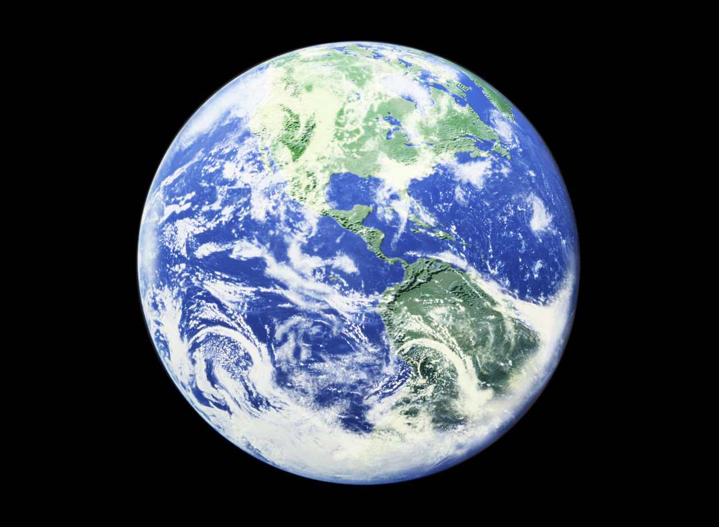
The Navajo Creation Myth
A Native American story about the earth.

